Slide 1

Music composed by AI

Slide 2
Information
Group 1
Yinxiang Gao;
Guanzhong You;
Chencheng Jiang;
Wenhang Bao;
Chang Liu
Credit to:
Karpathy
Manuel Araoz
Sherjil Ozair
Our work are built upon their work

Slide 3
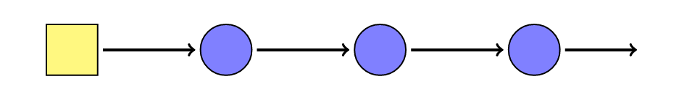
Neural Network
Input Vector
Hidden
Vector
Hidden
Vector
Hidden
Vector
Output
Vector

Slide 4
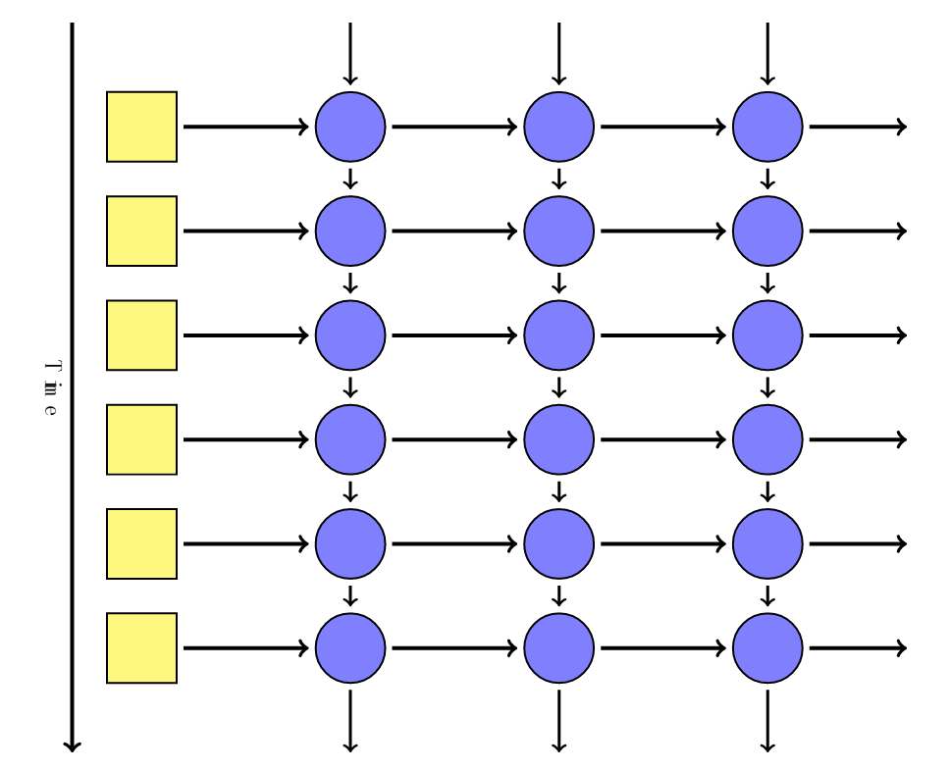
Recurrent Neural Network

Slide 5
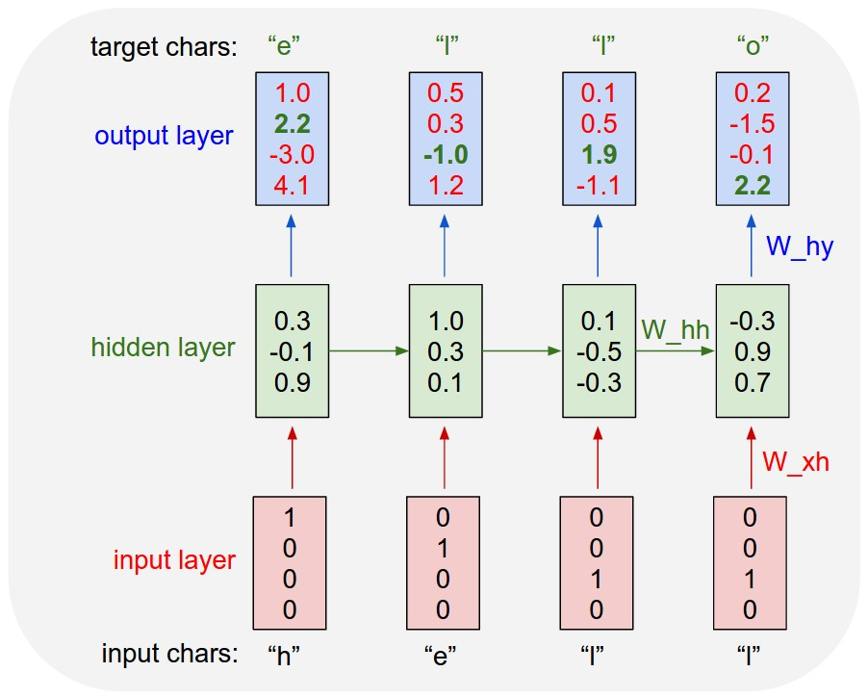
Example

Slide 6

Model Setting
Model: Long Short-Term Memory (LSTM)
# hidden layers: 2
# nodes in each hidden layer : 128
# epoch: 100
# memory: 50 chars
Loss function: logistic loss :

Slide 7
Training Data
ABC Notation
An 19th music notation with abcdefg as music note
Here is one popular Data Base
We use the data base as long as our own hand-made data
Including: Nottingham, Chinese pop and Chinese ShanGe style
Example
X:1
T:Speed the Plough
M:4/4
C:Trad.
K:G
|:GABc dedB|dedB dedB|c2ec B2dB|c2A2 A2BA|
GABc dedB|dedB dedB|c2ec B2dB|A2F2 G4:|
|:g2gf gdBd|g2f2 e2d2|c2ec B2dB|c2A2 A2df|
g2gf g2Bd|g2f2 e2d2|c2ec B2dB|A2F2 G4:|

Slide 8
Composing Rule
Generate ONE character each time, based on former string of characters
x
xx
xxx
…

Slide 9
Doubt ? No!
Does the algorithm cheat by copying a whole piece from some melody?
Does the algorithm cheat by generating some random notations with small jump?
Experiment:
Given a piece of starting melody, ask him to extend
Result:
He even knows how to repeat some part from the given starter with elaborate adjust !!!

Slide 10


Experiment Result
The original music from where I take out the starter
The generated music with the given starter
Of course I didn’t choose this melody from my training set!
The first 5 seconds are given, but then it develops well and even knows to repeat some part from the given melody!

Slide 11

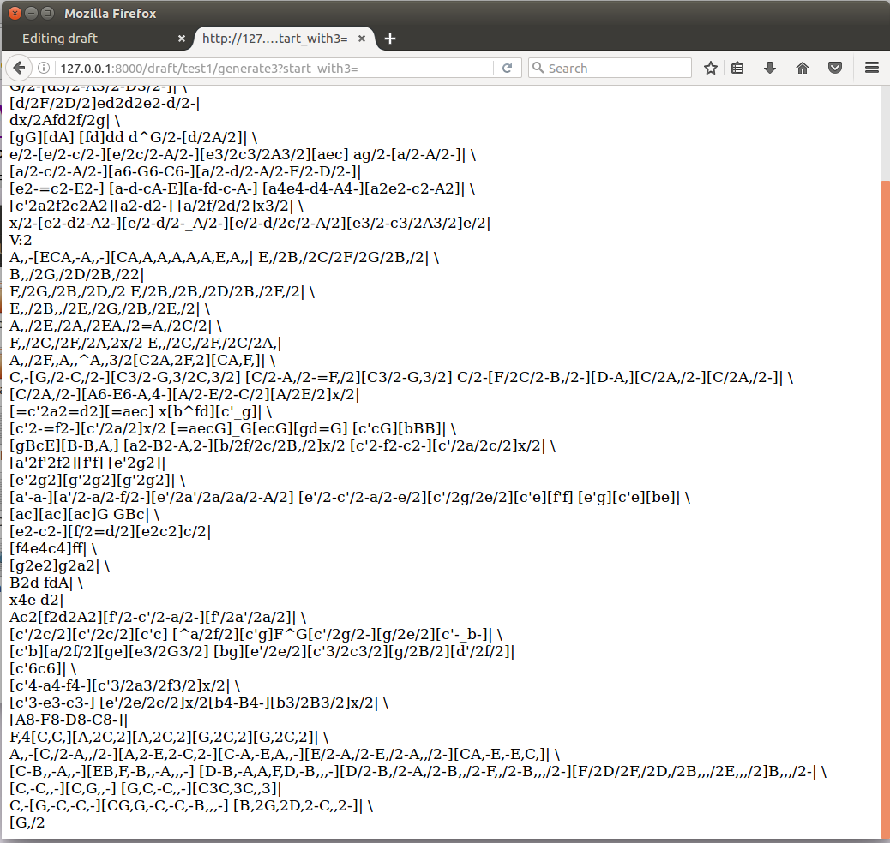
Web App

Slide 12
Reflections
The performance of neural network may highly depends on the data format fed into it, i.e. the feature and pattern should be easy to learn by machine.
The structure (# of layers, # of batchs, # of hidden layer states, etc) design is actually a bias variance trade-off. With more data, one can get a less biased (smarter) neural network.
The quality of generated music, in this state now, depends highly on the quality of training data. It is a pity that we can’t find the ABC notation of the most popular music, otherwise it is supposed to be better.

Slide 13

A FEW Generated melody
Nottingham Style
Chinese ShanGe (Folk) Style

Slide 14
Further Reading
Karpathy
Manuel Araoz
Sherjil Ozair
Daniel Johnson
Web2py

